Slide 1


Funding Aboriginal Organizations The ACCESS Model
John Webster, President & CEO
Presentation to Indigenous Funding Conference
September 2016 - Vancouver
Notes:
Good Morning/Afternoon
Thank you…..
Let me thank and acknowledge the Coast Salish people
We are blessed to be on their lands
Its great to see so many old faces, and some new ones as well.
This conference is so important, as we get stronger as a whole, by sharing what we’ve learned.
Today I am here to share some insights on how Indigenous organizations can access funds.

Slide 2


Today’s Topics
ACCESS
Mandate
Programs
Services
Funding Tips
Best Practices
Sources
Funding Sources
ACCESS Funds
For Organizations
For Clients
Urban Spirit Foundation
Partners - Types
What We Offer
What We Want
Conclusion/Contact
Notes:
My talk to day will focus on several key topics.
I’ll first tell you a bit about my organization ACCESS, and share some funding best practices we have come to understand over our first 18 years of operations.
I will tell you what we fund as an organization, including our own Urban Spirit Foundation.
And, I will also share a secret to our success – our partnerships.

Slide 3
ACCESS: Mandate
Mission
To increase Aboriginal participation in the labour market
ACCESS delivers a holistic blend of training, counselling, and support services that assist urban Aboriginal people to gain access to meaningful opportunities and employment.
2016 Funding
$13.1 million total
46.6% in ASET funds
53.4% in funds from governments and other partners
Only 7.9% in admin
Notes:
ACCESS is the Aboriginal Community Career Employment Services Society
We have been a non-profit society for the past 18 years, with an Aboriginal Board of Directors, management, and staff.
ACCESS is a partnership within the Aboriginal community. We have a Mandate to provide employment and training services
to First Nations and Aboriginal people.
ACCESS is the ASET holder for Metro Vancouver and Sunshine Coast. Do people know what I mean when I say ASET holder?
The federal government funds employment and training services for Aboriginal people through a network of community-based agencies called: Aboriginal Skills, Employment and Training agencies or ASETs.
So we serve the urban Aboriginal population of Greater Vancouver, and more recently, the five First Nations in the region:
Musqueam, Squamish, Tsleil’waututh, Tsawwassen, and Sechelt on the Sunshine Coast
We are demand-driven, which means we respond to the demand for jobs and skills form employers, to enhance and match the skills and career hopes from our clients.
We have partnerships with dozens of agencies, including key Aboriginal partners like the Native Education College, the Vancouver Aboriginal Friendship Centre, and the United Native Youth Association.
We also have a partnerships in Surrey with two other ASET holders, the Sto:lo and the Metis.
In 2015, our total budget was $13.1 million
Of that, 46.6% in ASET funds, and 53.4% in funds from governments and other partners
We are very happy that only 7.9% of the budget goes to admin costs, and the bulk goes to client services.

Slide 4
ACCESS: Programs
Employment Assistance Services
Essential Skills for Aboriginal Futures
Trades
Programs
BladeRunners
Urban Sprit Foundation
Corporate Services
Notes:
So what does ACCESS do with all that money, and the mandate to promote employment?
ACCESS operates with 7 main Departments. I’ll describe each as they have specific but overlapping functions.
1) EAS – Employment Assistance Services
Usually the first point of contact for clients. They meet employment counselors who screen and assess clients, and provide career direction. And most importantly, referrals to our other services
2) ESAF – Essential Skills for Aboriginal Futures
A unique Essential Skills Lab, that tailors Essential Skills assessments and upgrading, to the needs and requirements for specific jobs and specific employers. It is the foundation for all future success.
3) Trades
We provide specific training and apprenticeship services for those who want careers in the skilled trades.
We fund both single seat purchase for apprenticeship technical training, and group training programs for specific projects or industries. ACCESS Trades staff work with clients from green to red. From pre-apprenticeship, to apprenticeship training and jobs, all the way through to Red Seal
4) Programs
Our Programs Department partners with other agencies to provide job and employment specific training.
Key projects are Summer Students, Pre-employment Programs, and Skill Enhancement Programs. ACCESS flows over $3 million to the five First Nations for training programs and daycare.
5) BladeRunners
BladeRunners is a provincially funded program for at risk youth. ACCESS manages the funding for 20 BladeRunners sites across the province. Through BladeRunners youth gain provides entry-level construction skills, safety certifications, and employment opportunities.
6) Urban Spirit Foundation
Several years ago we launched a registered charity to be able to take in donations, and to direct these funds to gaps in the system. I will explain more about this a little later.
7) Corporate Services
One of the secrets to our success is our Corporate Services Department. While the other departments deal with clients, our Corporate team deals with the finances, and the extensive reporting required for governments and other funders and partner.

Slide 5

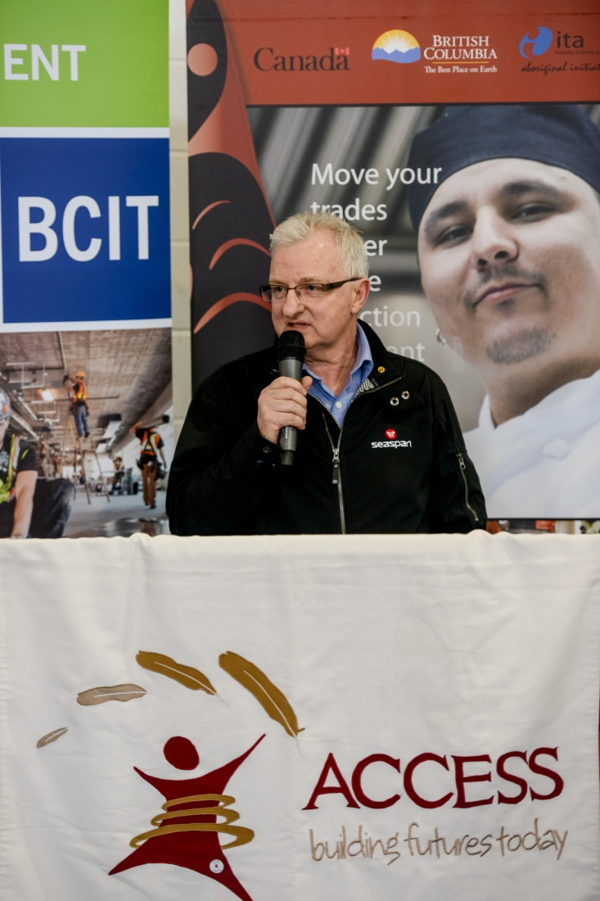
ACCESS: Services
Metro Vancouver & Sechelt
ASET +
5 First Nations
5 Locations
Strategic Partnerships
Notes:
ACCESS provides the full spectrum of employment and training services
We recruit clients and conduct a detailed intake
We access funds for clients from multiple sources
We provide training and supports while training
We facilitate employment, including job search skills and referrals
But we know, and you know, there are so many cracks in the system for our people to fall through
ACCESS works hard to give our clients the full range of support they need to succeed
of support they need to succeed.
That’s why when we accept a client, they go through our other key departments like EAS and Essential Skills, so we know they get the best support we can offer

Slide 6


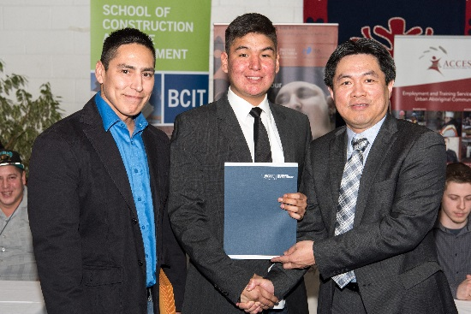
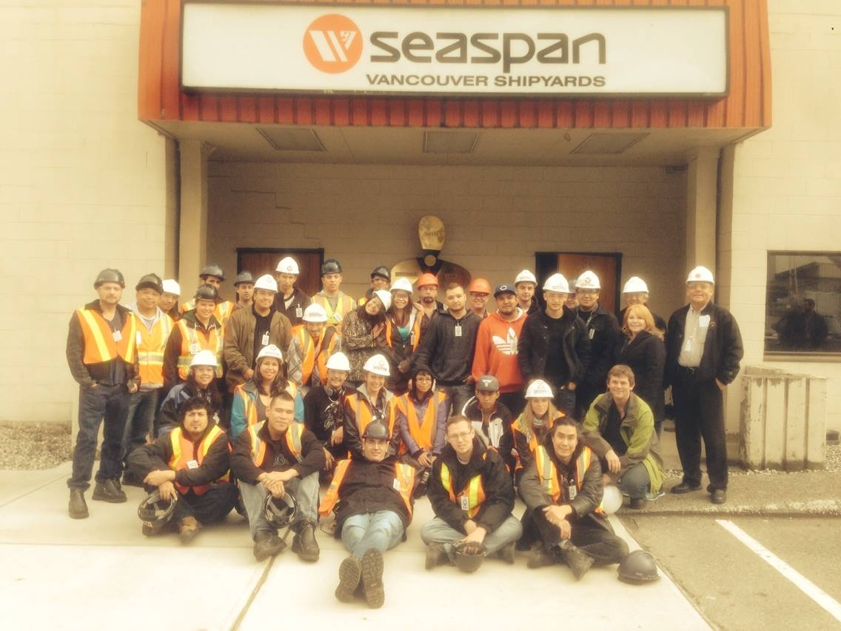
Results 2015/16
1,224
Youth
504
2,297
Employed
Clients Served
Notes:
ACCESS gets results. Good results. Really good results.
In 2015/16, we served:
2,297 clients across all locations
239 persons with disabilities
1,124 youth
504 became directly employed
That means 504 Indigenous people in the Greater Vancouver area that are now able to chart their own career, pay their own bills, support their own family, build their own community.
Each of our Departments added to our success:
Employment Assistance conducted intakes for almost 2,300 clients over our 3 locations in Vancouver and Surrey
ESAF ran programs to support the Trades and the City of Vancouver’s call centre
ACCESS Trades manages 521 apprentices in 37 different trades ranging from 210 in Level 1 apprenticeships to 58 with Red Seals. They also found the time to forge a partnership with Seaspan and the Coast Salish Employment and Training Society, our sister ASET holder on southern Vancouver Island.
In addition, BladeRunners served 1,109 clients over 20 sub-agreements, including 145 by ACCESS alone.
Our First Nation partners also had success:
Squamish Nation also utilizes multiple partners to fund their key programs and like the Stistma, Eslha7an, and the Squamish Nation Trades Centre
Musqueam ran a landscaping course to meet the demands of their area, and the 3 golf courses they own
Tsleil’waututh ran an Essential Skills program
Tsawwassen addressed the demand with their new mall and industrial park, with programs for cashiers and warehouse workers
And Sechelt ran a Forestry program to meet the needs of their local employers
We are very proud of that.

Slide 7

Funding Tips: Best Practices
Know Who You Are
Know What You Want
Your mandate
Your strengths
Your weaknesses
Your capacity
Your needs
Your clients’ needs
Expertise, Dollars, Contacts
Strings we can handle
Commitments we can deliver
Partners that can help us
Opportunity to build capacity
Notes:
At ACCESS we are NOT driven by money.
We are driven by the needs of our clients, and by results.
Everything we do has a purpose, everything we do has a plan.
Chasing dollars takes time, and can easily lead us off track.
Every fund we apply for, every partnership we establish, takes valuable time away from clients, away from our core purpose.
So it better be valuable, it better be useful.
When we take on a new fund, a new project, we have a plan to implement it from start to finish.
We judge whether or not it makes economic sense and provides long term opportunities for our clients.

Slide 8

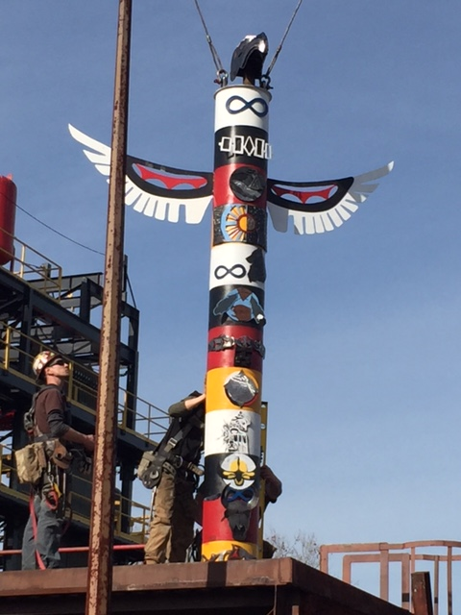
Funding Sources
Canada - Government
Province BC - Government
Local Industry
Foundations
Other Partners
Notes:
We cast our net far and wide, for funders and partners.
The Government of Canada is our primary finder. As an ASET holder our main funder is the Government of Canada (Service Canada, INAC), including EI dollars. BladeRunners is funded by the Province of British Columbia.
We also deliver other programs and services from both the federal and provincial governments, including the recent Skills and Partnership Funds. And many of our projects have multiple funders, all with their own application processes, their own reporting requirements, and their own specific rules. Some of the ACCESS Trades programs for example are funded by the Industry Training Authority of BC.
Make no mistake, the application process is extensive, and the reporting is sometimes never ending. We work for those dollars.
We also work with the Cities of Vancouver and Surrey. Sometimes it is training to employment with the city or they direct our trainees to specific projects taking place in the city to train and employ our people.
Industry associations, and large employers – for large scale projects, like trades training with Seaspan and the marine industry.
By having companies like Seaspan committed to a project, and to hire graduates, this allows us to pursue government dollars for targeted training.
We also partner, or work with training providers, such as:
Colleges like BCIT, NEC, Douglas, and Camosun College
Industry trainers like IMTARC with the marine industry
Unions like the UA Piping Industry College
and union organizations like the Electrical Joint Training Committee.

Slide 9

ACCESS: What We Fund
Clients
Organizations
Training (tuition), tutoring
Certificates
Transportation
Books, books, equipment
Living Allowance
Trainers – seats and groups
Programs
BladeRunners
Cost Sharing
Notes:
As an Indigenous organization, we also provide fund for clients, and to many other organizations
For clients, we can fund
Training (tuition), tutoring
Certificates
Transportation
Books, books, equipment
Living Allowance
On behalf of our clients we purchase training for individual seats, and for group training
Through and RFP process we also fund programs delivered by other organizations such as Native Education College, Circle of Eagles, Helping Spirit Lodge and 10 summer students with employers like UBC, Aboriginal Tourism of BC, the Vancouver Aboriginal Friendship Center, and Kwikwetlem First Nation to name a few examples.
On behalf of the Province, we manage and fund 20 BladeRunners programs across BC in locations like Vancouver, Victoria, Ft St John, Williams Lake, and Lillooet… all in partnership with First Nations or other organizations working in employment and training.
But wherever possible, we cost share.
For many of our clients, we cost share items with First Nations, and other ASETS, in order to maximize all of our funding.

Slide 10
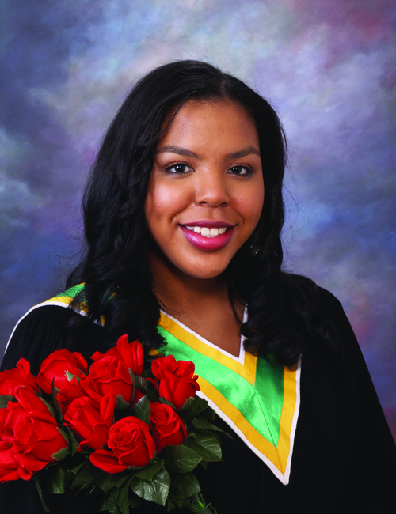
Urban Spirit Foundation
Scholarships/Bursaries
Fundraising
Back to School Back Pack
Friendship Centre
Children’s Christmas
Scholarships
School Boards
Corporate donors
Individual donors
Golf Tournament
Staff
Chili
Notes:
Several years ago we noticed a gap in funding for many of our clients, people caught in no man’s land between what we could fund as an ASET holder, what First Nations could fund, and our clients ability to pay for post-secondary education and training.
So after research and consultations with our stakeholders and community, we established a separate private foundation to raise money and to fill these gaps.
The Urban Spirit Foundation provides:
Funds for the Back to School Back Pack program by the Vancouver Aboriginal Friendship Centre
Funds for the Children’s Christmas Program
Scholarships for secondary and post-secondary students through the school boards in Vancouver, Surrey and Burnaby. We also provide scholarships to Native Education College, BCIT, and NVIT.
We raise money through an annual golf tournament, corporate, and individual donors.
We also run an inter-office contest each year to raise money from our own staff. Our Chili fund raising Lunches have become legendary at the Black Tower on Squamish lands in West Vancouver.

Slide 11
Partners: Types
First Nations
Other ASETs
Indigenous Organizations
Industry Associations
Labour/Unions
Employers
Trainers
Governments
Notes:
But I’ll let you in on a little secret.
We don’t know everything, and we need help to support our clients.
The funds from the government are essential, but the key to our success is partnerships
We partners with the private and public agencies that can bring real substance to the table.
We look for: Jobs – Expertise -- Industry Insight -- Contacts
We surround ourselves with those with the shared goals of training and employing Aboriginal people.
We are proud that so many of our partners are other Indigenous organizations, including our sister ASET holders, our First Nations, and key partners like the Friendship Centre and the Native Education College.
In fact, our 3 way partnership to provide employment services at the Aboriginal Training Employment Cooperative Surrey with the Sto:Lo and the Metis, has become a great model of 3 agencies working smoothly together with a focus on clients.
We want to build our collective capacity, share our knowledge, and learn from each other.

Slide 12
Partners: What We Offer
Strong Infrastructure – Capacity
Board
Management
Staff
Strong Finances - Open
On time
On budget
Transparent
Experience – Project Success
Project design
Project management
Partnerships
Ideas – Dream Projects
Stick to mandate
Stick to strengths
Expand services
Notes:
When we go looking for partners, we must first be clear on what we offer ourselves
We bring an organization with strong capacity from our Board, to our managers, to our staff. And we are always learning. We are always training ourselves.
We bring open and accountable finances, with a good reputation with our funders and partners.
We know where our money is at all times.
We also bring experience managing projects. We can help design a project, manage a project and build partnerships.
And we have ideas. We know where we have gaps, and know how we want to fill them.
We know this, because we plan. We build and maintain strategic documents, that identify where we want to go next.
When you have a good plan that fills a demand, and know you’re strengths and what you need, finding the money can be the easiest part.

Slide 13
Partners: What We Want
Partners who know their own strengths and weaknesses
Transparent finances
Expertise we don’t have
Similar mandates
Solid reputation
Cash
Jobs
Training
Certifications
Opportunities for Networking
Notes:
The second thing when exploring new partnerships or funders, is knowing what you want from them.
And the golden rule is….know who you’re getting in bed with…
We want partners who know their own strengths and weaknesses.
We want partners and funders with similar mandates, but with different strengths
Of course we want money, but we also want jobs, training opportunities, industry certifications, and connections

Slide 14
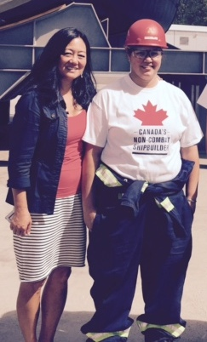
Key Points
Know your mandate
Know your finances
Know what you offer
Know what you want
Network
Notes:
So I want to leave you with five main points from my talk today
Know your mandate
Know your finances
Know what you offer
Know what you want
Network

Slide 15

Thank You
John Webster
President & CEO
jwebster@accessfutures.com
(604) 913-7933
www.accessfutures.com
Notes:
My Name is John Webster and I’m honoured to be the President and CEO of ACCESS
I am proud of our people,
Proud of our organization, proud of our partnerships
And even prouder of all of the wonderful clients, who are now working hard and raising their own families
We are in incredible position at ACCESS because we get feedback from clients
We hear from them, and we know their lives are better because they have a career
We do it with the support of our funders, with the help of our partners
We do under the direction of our Board of Directors, our First Nations, and our people
Thank you so much for taking part with us here today

